Slide 1
Front End Engineering-I Project (BMI Calculator)
Team Details:
GARV SAPRA (2410990280)
GARVITA KALRA (2410990281) – Team Leader
GAURAV(2410990282)
Faculty Coordinator:
:
Chitkara University Institute of Engineering and Technology,
Chitkara University, Punjab

Slide 2
Table of Contents
Introduction
Problem Statement
Technical Details
Key Features
Project Highlights
Conclusion
References/Links used

Slide 3
Introduction
This project is a simple BMI (Body Mass Index) Calculator built with HTML , CSS AND JAVSCRIPT. It allows users to input their weight and height to calculate their BMI, helping them understand their health status. This project showcases basic web development skills, focusing on both functionality and design.

Slide 4
Problem Statement
The BMI Calculator project addresses the need for a simple, accessible tool to help individuals assess their health based on their weight and height. With increasing global concerns about obesity and undernutrition, many people lack easy access to professional tools for evaluating their body composition.
This project simplifies BMI calculations, providing users with quick and accurate insights into their health status.

Slide 5
Technical Details
Technologies and Methods:
HTML :Used to structure the webpage, including the input fields for height and weight, as well as the button for calculating the BMI. HTML forms were key in gathering user input.
CSS :Applied to design and style the BMI calculator, making the user interface visually appealing and responsive. CSS was used to control layout, colors, fonts, and spacing for a better user experience.
JavaScript: For calculating the BMI and dynamically updating the result and comments based on user input.
Together, HTML and CSS provided a functional, clean, and responsive BMI Calculator.

Slide 6
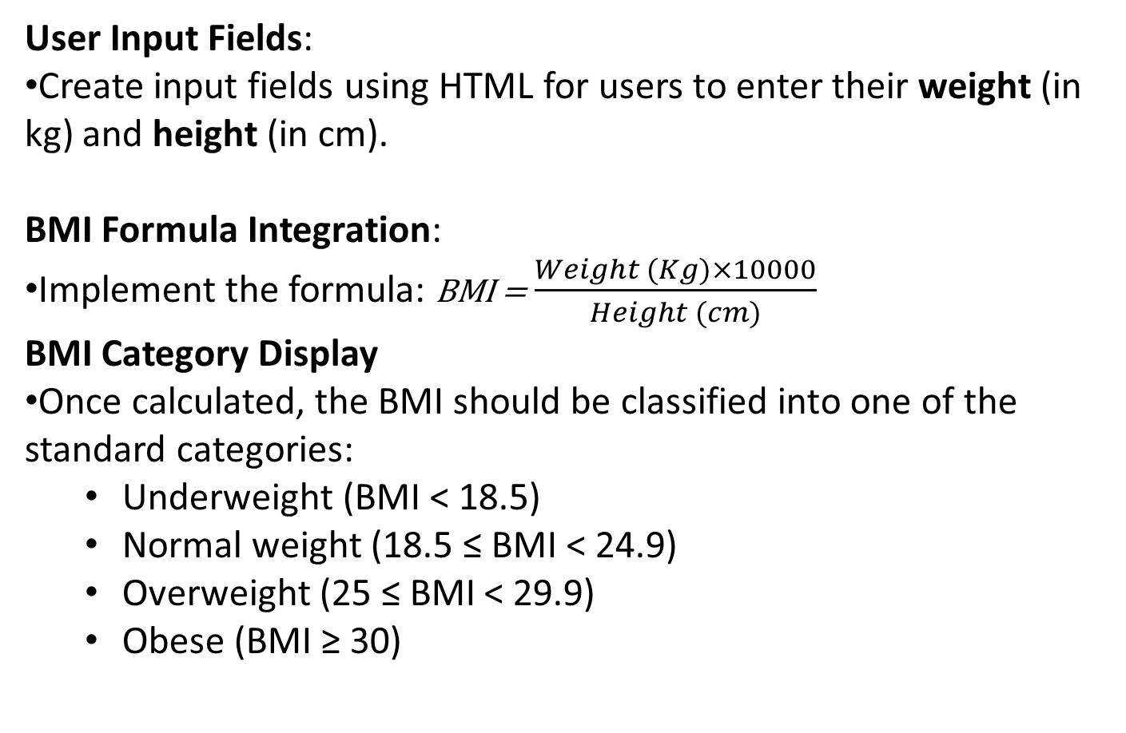
Key Features
User Input Fields:
Create input fields using HTML for users to enter their weight (in kg) and height (in cm).
BMI Formula Integration:
Implement the formula: BMI = $\frac{Weight (Kg)×10000}{Height (cm)}$
BMI Category Display
Once calculated, the BMI should be classified into one of the standard categories:
Underweight (BMI < 18.5)
Normal weight (18.5 ≤ BMI < 24.9)
Overweight (25 ≤ BMI < 29.9)
Obese (BMI ≥ 30)

Slide 7
Key Features
Responsive Design:
Use CSS to ensure the layout is responsive and works well across various screen sizes (mobile, tablet, desktop).
Styling and Layout:
Apply CSS for visually appealing forms, buttons, and result display. Make use of padding, margins, and fonts to create a clean interface.
Validation for Inputs: Ensure HTML form validation to guide users in providing valid inputs.
Display BMI Result:
A section to display the calculated BMI result along with a category based on the BMI value.

Slide 8
Project Highlights(Home)
Project Structure and Styling:
HTML structure creates a visually appealing BMI calculator interface.
CSS is used to apply a sleek, modern design with a dark-themed background, clean typography, and rounded container borders for a professional appearance.
Uses Google Fonts (Nunito) for typography to improve readability.
Buttons and links have subtle hover effects, enhancing user experience.
Navigation Bar:
A responsive, dark-themed navigation bar is included at the top with links to “Home,” “Know More,” and “Contact” pages.
Provides easy access to other sections of the website.
Input Fields:
User inputs are captured through input fields for height (in cm) and weight (in kg).
Gender selection is made possible via radio buttons with labels, giving the form a more comprehensive look.

Slide 9
Project Highlights
JavaScript BMI Calculation:
The core functionality is implemented in JavaScript, with a function calculateBMI() that calculates BMI based on user inputs.
Checks for valid inputs; if height or weight is missing, it displays an error message in place of the BMI result.
Calculates BMI using the formula: BMI=weight (kg)(height (m))2\text{BMI} = \frac{\text{weight (kg)}}{(\text{height (m)})^2}BMI=(height (m))2weight (kg)​.
BMI result is displayed with two decimal precision.
BMI Interpretation:
Based on the calculated BMI, a comment provides feedback on the BMI category (Underweight, Normal weight, Overweight, Obesity).
Updates dynamically as soon as the "Calculate BMI" button is clicked.
Responsive and Aesthetic Design:
CSS includes responsive layout adjustments for usability on different screen sizes.
Background with a shadow overlay gives depth, and box shadows create a polished, layered look for the input sections.
Colors and styling choices make the interface visually appealing and easy to navigate.

Slide 10
Project Highlights
Error Handling and User Guidance:
Basic error handling prompts users to enter valid numbers for both height and weight.
Informative feedback makes it accessible even for users unfamiliar with BMI calculations.

Slide 11
WHY OUR BMI CALCULATOR?
1. Clear Separation of Concerns
HTML, CSS, and JavaScript Segmentation: Each component of the page (structure, styling, functionality) is well-separated, which is crucial for maintainability, readability, and scalability. This makes the code easy to update or expand without confusion, demonstrating an understanding of best coding practices.
2. User Experience (UX) and Interface Design
Visual Aesthetics:
The page uses a dark background with contrasting light elements to make the content stand out, giving it a professional, polished look.
The chosen fonts and rounded button edges contribute to a modern and friendly design.
Hover effects on the navigation links add interactivity, which enhances the user's experience and shows attention to detail.
Responsive Design Elements:
The central positioning of the calculator and balanced spacing provide a consistent layout across screen sizes.
The button and input fields are accessible and easy to interact with, showcasing awareness of responsive and accessible design principles.

Slide 12
3. Form Validation and User Feedback
Input Validation:
The JavaScript code checks if the user has provided valid height and weight values. This error handling improves reliability and user experience, as users won’t see nonsensical results if they forget an input.
User Feedback: When there’s a validation error, a friendly message prompts the user to correct their inputs, which is crucial for user experience and indicates a robust approach to error handling.
Dynamic Results Display:
The page immediately shows the calculated BMI and relevant category (e.g., "Underweight," "Normal weight") based on the result. This interactivity is engaging and informative, guiding users with clear, categorized feedback.
4. Modularity and Maintainability
Reusable Styles: The CSS code includes reusable styling for elements like buttons, labels, and input fields, meaning that updates to styling are easy to apply consistently.
JavaScript Function Encapsulation: The calculateBMI function is encapsulated in a single script, making the functionality modular and easy to extend. If other features or health calculators were added, it could reuse or modify this function with minimal adjustments.

Slide 13
Project Highlights
<!DOCTYPE html>
<html lang="en">
<head>
<meta charset="UTF-8">
<meta name="viewport" content="width=device-width, initial-scale=1.0">
<title>BMI CALCULATOR</title>
<style>
@import url("https://fonts.googleapis.com/css2?family=Nunito:wght@600;700;800;900&display=swap");
* {
padding: 0;
margin: 0;
box-sizing: border-box;
}
body {
min-height: 100vh;
background: url("https://wallpapers.com/images/hd/dark-grey-background-phpf8ys7h4fgijgt.jpg");
background-size: cover;
background-repeat: no-repeat;
font-family: "Nunito", sans-serif;
}

Slide 14
Project Highlights
nav {
background-color: #050506;
display: flex;
align-items: center;
justify-content: space-between;
padding: 15px;
color: #ffffff;
}
nav .title {
font-size: 22px;
font-weight: 800;
color: #f3f4f9;
margin-left: 20px;
text-transform: uppercase;
}
nav a {
color: #fff;
text-decoration: none;
font-size: 18px;
margin: 0 10px;
font-weight: 700;
transition: color 0.3s ease;
}
nav a:hover {
color: #0044ff;
}

Slide 15
Project Highlights (Home)
.container {
position: absolute;
left: 50%;
top: 15%;
transform: translate(-50%, 0%);
}
.box {
min-width: 400px;
background: #fafafa;
border-radius: 38px;
text-align: center;
position: relative;
margin-bottom: 50px;
background-color: lightgray;
box-shadow: inset;
border-style: groove;
border-color: #050506;
}
.box::before {
content: "";
position: absolute;
height: 50%;
width: 110%;
left: -5%;
top: -5%;
background-color: rgba(30, 32, 35, 0.963);
box-shadow: 0px 0px 166px -31px rgba(0, 0, 0, 0.15);
border-radius: 60px;
z-index: -1;

Slide 16
Project Highlights
h1 {
font-weight: bold;
font-size: 36px;
padding: 30px 0;
font-family: 'Gill Sans', 'Gill Sans MT', Calibri, 'Trebuchet MS', sans-serif;
font-style: italic;
}
.content {
padding: 0 40px;
}
.input {
background: #fff;
box-shadow: 0px 0px 95px -30px rgba(0, 0, 0, 0.15);
border-radius: 28px;
padding: 20px 0;
margin-bottom: 20px;
}
.input label {
display: block;
font-size: 18px;
font-weight: 600;
color: #000;
background-color: white;
margin-bottom: 10px;
font-style: italic;
}

Slide 17
Project Highlights
.input input[type="number"] {
outline: none;
border: none;
border-bottom: 1px solid #4f7df9;
width: 60%;
text-align: center;
font-size: 28px;
font-family: "Nunito", sans-serif;
}
.gender-input {
display: flex;
justify-content: center;
gap: 20px;
padding: 10px 0;
}
.gender-input label {
font-size: 18px;
font-weight: 600;
color: #000;
}
.gender-input input[type="radio"] {
margin-right: 8px;
}

Slide 18
Project Highlights
button#calculate {
font-family: "Nunito", sans-serif;
color: #fffcfc;
background: #050506;
font-size: 16px;
border-radius: 12px;
padding: 12px 0;
width: 100%;
outline: none;
border: none;
transition: background 0.2s ease;
}
button#calculate:hover {
background: #000209;
}
.result {
padding: 30px 20px;
}
.result p {
font-weight: 600;
font-size: 22px;
color: #000;
margin-bottom: 15px;
}

Slide 19
Project Highlights
.result #result {
font-size: 36px;
font-weight: 900;
color: #4f7df9;
background-color: #eaeaea;
display: inline-block;
padding: 7px 20px;
border-radius: 55px;
margin-bottom: 25px;
}
#comment {
color: #4f7df9;
font-weight: 800;
}
</style>
</head>
<body>
<nav>
<div class="title">Body Mass Index Calculator</div>
<div>
<a href="homepage.html">Home</a>
<a href="knowmore.html">Know More</a>
<a href="contact.html">Contact</a>
</div>
</nav>
=

Slide 20
Project Highlights
<div class="container">
<div class="box">
<h1>BMI CALCULATOR</h1>
<div class="content">
<div class="input">
<label for="height">Height(cm)</label>
<input type="number" id="height">
</div>
<div class="input">
<label for="weight">Weight(kg)</label>
<input type="number" id="weight">
</div>
<div class="input">
<label>Gender</label>
<div class="gender-input">
<label><input type="radio" name="gender" value="male"> Male</label>
<label><input type="radio" name="gender" value="female"> Female</label>
</div>
</div>
<button id="calculate" onclick="calculateBMI()">Calculate BMI</button>
</div>
<div class="result">
<p>Your BMI is</p>
<div id="result">00.00</div>
<p id="comment"></p>
</div>
</div>
</div>
<script>

Slide 21
Project Highlights(About)
function calculateBMI() {
const height = parseFloat(document.getElementById("height").value);
const weight = parseFloat(document.getElementById("weight").value);
const result = document.getElementById("result");
const comment = document.getElementById("comment");
if (!height || !weight) {
result.innerText = "00.00";
comment.innerText = "Please enter valid height and weight values.";
return;
}
const bmi = weight / ((height / 100) ** 2);
result.innerText = bmi.toFixed(2);
if (bmi < 18.5) {
comment.innerText = "Underweight";
} else if (bmi >= 18.5 && bmi < 24.9) {
comment.innerText = "Normal weight";
} else if (bmi >= 25 && bmi < 29.9) {
comment.innerText = "Overweight";
} else {
comment.innerText = "Obesity";
}
}
</script>
</body>
</html>

Slide 22
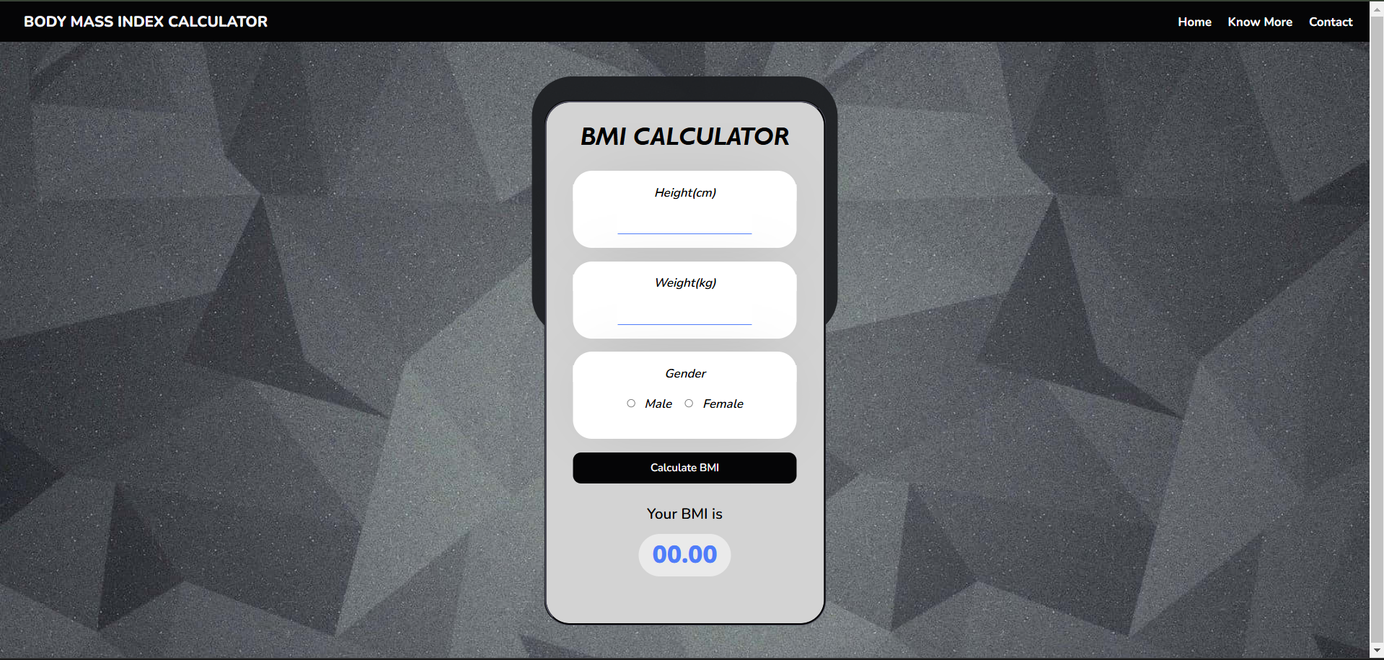
Project Highlights
Project Output :

Slide 23
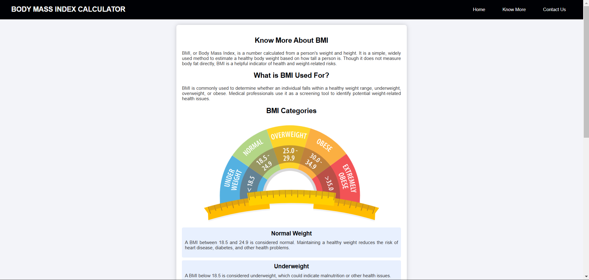

Slide 24
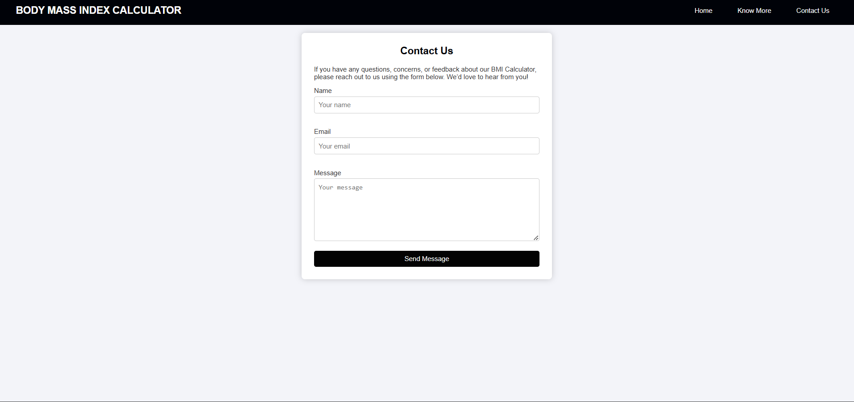

Slide 25
Conclusion
We developed a BMI Calculator using HTML ,CSS And JS allowing users to input their height and weight to calculate their BMI and assess their health status.
Key Takeaways:
Web Development Skills: Enhanced our proficiency in HTML and CSS for building and styling forms.
User-Centered Design: Emphasized the importance of a user-friendly, responsive interface.
Collaboration: Strengthened teamwork in overcoming challenges and improving design.

Slide 26
References/Links used
HTML and CSS Documentation:
Mozilla Developer Network (MDN) Web Docs: HTML | CSS
BMI Calculation Formula:
World Health Organization (WHO): BMI Classification
Input Validation Techniques:W3Schools: HTML Form Validation
Sample Projects and Tutorials:
FreeCodeCamp: Build a Simple BMI Calculator
Codecademy: Learn HTML & CSS

Slide 27


